Slide 1



ITI1121A
LAB #2
Friday 11:30 – 14:30
Professor: Nour El-Kadri
TA: Berk Soysal
bsoys096@uottawa.ca
Office Hour: Fridays 15:00 – 16:00
Office Location: SITE 5000D
Download this ppt. - http://uottawa.ml
2016 Winter Prepared by Berk Soysal for ITI1121A

Slide 2
Data Types
Variables are nothing but reserved memory locations to store values.
This means that when you create a variable you reserve some space in memory.
Based on the data type of a variable, the operating system allocates memory for this variable.
2016 Winter
Download this ppt. - http://uottawa.ml

Slide 3
Data Types
There are two data types available in Java:
Primitive Data Types,
Reference/ Object Data Types
2016 Winter
Download this ppt. - http://uottawa.ml

Slide 4
Primitive Data Types
There are eight primitive data types supported by Java.
Primitive data types are predefined by the language and named by a keyword.
These are;
Byte, Short, Int, Long, Float, Double, Boolean, Char, String(Not Primitive, Strings are Objects)
Example→ uottawa.ml→Lab2→ Lab2 Exercises→ TimeConversion.java
2016 Winter
Download this ppt. - http://uottawa.ml

Slide 5
Primitive Data Types
Byte:
8 bit signed.
Minimum value is -128 (-2^7)
Maximum value is 127 (inclusive)(2^7 -1)
Default value is 0
Byte data type is used to save space in large arrays, mainly in place of integers, since a byte is four times smaller than an int.
2016 Winter
Download this ppt. - http://uottawa.ml

Slide 6
Primitive Data Types
Short:
16-bit signed
Minimum value is -32,768 (-2^15)
Maximum value is 32,767 (inclusive) (2^15 -1)
Short data type can also be used to save memory as byte data type. A short is 2 times smaller than an int
Default value is 0.
Example: short s = 10000, short r = -20000
2016 Winter
Download this ppt. - http://uottawa.ml

Slide 7
Primitive Data Types
Int:
32-bit signed
Minimum value is - 2,147,483,648.(-2^31)
Maximum value is 2,147,483,647(inclusive).(2^31 -1)
Long:
64-bit signed
Minimum value is -9,223,372,036,854,775,808.(-2^63)
Maximum value is 9,223,372,036,854,775,807 (inclusive). (2^63 -1)
2016 Winter
Download this ppt. - http://uottawa.ml

Slide 8
Primitive Data Types
Float:
32-bit floating point.
Float is mainly used to save memory in large arrays of floating point numbers.
Default value is 0.0f.
Float data type is never used for precise values such as currency.
Double:
64-bit floating point.
All the other properties are similar to float.
2016 Winter
Download this ppt. - http://uottawa.ml

Slide 9
Primitive Data Types
Boolean:
Represents one bit of information.
There are only two possible values: true and false.
This data type is used for simple flags that track true/false conditions.
Default value is false.
Example: boolean var = true;
Char:
char data type is a single 16-bit Unicode character.
Minimum value is '\u0000' (or 0).
Maximum value is '\uffff' (or 65,535 inclusive).
Char data type is used to store any character.
Example: char letter ='A'
2016 Winter
Download this ppt. - http://uottawa.ml

Slide 10
Reference Data Types
Reference variables are created using defined constructors of the classes. They are used to access objects.
Class objects, and various type of array variables come under reference data type.
Default value of any reference variable is null.
Example: Animal mydog = new Animal(“Dog");
2016 Winter
Download this ppt. - http://uottawa.ml

Slide 11
Type Casting
Assigning a value of one type to a variable of another type is known as Type Casting.
Example :
long l = 100000; // Adjust this value
short s = (short) l;
System.out.println(s);
2016 Winter
Download this ppt. - http://uottawa.ml

Slide 12
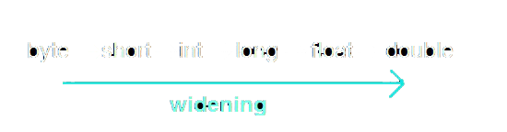
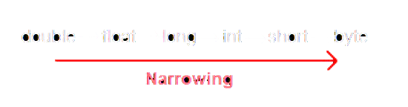
Type Casting
There are two different types of type casting:
Implicit (Widening) Casting,
Explicit (Narrowing) Casting.
2016 Winter
Download this ppt. - http://uottawa.ml

Slide 13
Implicit Casting
Implicit conversion is automatic in Java,
Information is preserved.
Example:
short s = 4;
int i = s;
int
short
2016 Winter
Download this ppt. - http://uottawa.ml

Slide 14
Explicit Casting
Explicit conversion is NOT automatic,
There MIGHT be some losses.
Example:
int i = 100;
// Explicit type casting required
short s = (short) i;
int
short
2016 Winter
Download this ppt. - http://uottawa.ml

Slide 15
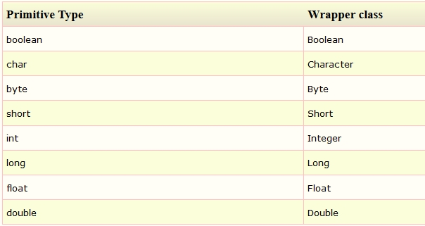
Wrapper Classes
Each primitive data type has a corresponding “wrapper” class.
As the name “wrapper” suggests, such class packages a value inside an object. .
2016 Winter
Download this ppt. - http://uottawa.ml

Slide 16
Guard a Type Casting
Always guard a type casting with the proper test to ensure that the value is in the proper range. Example:
int i = 100000;
Short s;
if (i < Short.MAX_VALUE)
s = (short) i;
else
System.out.println(“Data Loss”);
2016 Winter
Download this ppt. - http://uottawa.ml

Slide 17
ParseInt(String s)
ParseInt method of Integer class converts a String s
into an integer; Example:
String s1 = "9";
String s2 = "4";
//Observe the difference
System.out.println(s1+s2);
System.out.println ((Integer.parseInt(s1)+Integer.parseInt(s2)));
2016 Winter
Download this ppt. - http://uottawa.ml

Slide 18

Object Oriented Programming
Java is an OOP language.
An Object is an entity that has states and behaviors.
Look around right now and you'll find many examples of real-world objects: your dog, your desk, your television set, your bicycle..
A Class is a group of objects
that has common properties.
It is a template or blueprint
from which objects are created.
2016 Winter
Download this ppt. - http://uottawa.ml

Slide 19
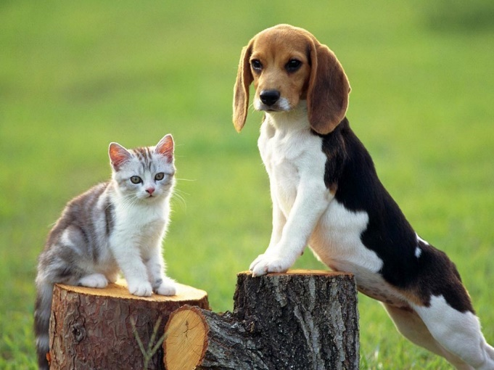
Object – Class Relationship
Example:
Let’s create an Animal Class and a Cat and a Dog Object !
Create 2 classes. (Animal and Main)
Animal must have a name, an age and a color attribute.
Also Animal must have setAge(), getName(), getType() and getAge() methods.
Create a Cat and a Dog object with
different attributes.
2016 Winter
Download this ppt. - http://uottawa.ml

Slide 20
Random Number Generation in Java
There are two built-in classes that we can use to generate random numbers in Java.
Math Class random() method,
Java.util.Random Class nextInt(n) method.
2016 Winter
Download this ppt. - http://uottawa.ml

Slide 21
Math.random()
Random() method returns a value greater than 0.0 and
less than 1.0. With a simple calculation we can generate numbers for any range:
int range = (maximumValue - minimumValue) + 1; int value = (int)(Math.random()*range) + minimumValue;
Example (A random number between 1 and 5):
int range = (5 - 1) + 1; int value = (int)(Math.random()*range) + 1;
2016 Winter
Download this ppt. - http://uottawa.ml

Slide 22
java.util.random.nextInt(n)
Method nextInt(int n) which returns an int value between zero (inclusive) and n (exclusive).
Basically, this approach is cleaner and easier to read to get random number of a given type uniformly distributed over a range of your chance.
Example (A random number between 1 and 5): Random generator = new Random();
int value = generator.nextInt(5) + 1;
Comparison of the mentioned random number generator methods.
http://stackoverflow.com/questions/738629/math-random-versus-random-nextintint
2016 Winter
Download this ppt. - http://uottawa.ml

Slide 23
IN - LAB EXAMPLE
Combination, DoorLock, and SecurityAgent classes
will be implemented.
Please read index_lab2.pdf carefully and try to implement these classes by yourselves.
Use the given Test.java to run your program.
2016 Winter
Download this ppt. - http://uottawa.ml

Slide 24
Quiz Question
public class Quiz { public static void main(String[] args) { String s = null; if (s.length() > 0) System.out.println(s); else System.out.println("empty string"); } }
Which of the following statements is true for the program above? 1. The program runs without error, but displays nothing on the console. 2. Displays a message of the form “String@5e8fce95” on the console. 3. Displays “empty string” on the console. 4. Produces a compile-time error. 5. Produces a run-time error: Exception in thread "main" java.lang.NullPointerException at Quiz.main(Quiz.java:4)
2016 Winter
Download this ppt. - http://uottawa.ml

